Slide 1
TITLE: A WELL-STRUCTURED REPORT ON EIGHT (8) DATASETS (12-YEAR GASOLINE, AGRICULTURE, CONSUMER FOOD, ENERGY, FINANCIAL, INTERNATIONAL LABOR, MANUFACTURER, U.S. INTERNATIONAL STOCK MARKET AND MATH SCIENCE TEST DATABASE) USING DETAILED DATA ANALYSES WITHIN THE CONTEXT AND FRAMEWORK OF BUSINESS ANALYTICS. GROUP 2 GROUP MEMBERS STUDENT ID 10845948 10845036 10839787 10846220 10836491

Slide 2
INTRODUCTION
This report presents a comprehensive analysis of two distinct datasets, each with its own unique insights and implications for decision-makers. The first dataset comprises eight sets of data covering a wide range of economic sectors and industries, including gasoline prices, financial data, consumer food, agricultural statistics, energy sector trends, international labor, manufacturers, and the US international stock market trends. Spanning a 12-year period, these datasets provide a comprehensive view of the economic landscape, highlighting the interdependence and correlation between different sectors and industries.
This report will provide a detailed analysis of both datasets, including key findings and implications for decision-makers in various sectors. It will conclude with a summary of the most significant findings and recommendations for businesses, policymakers, and educators. By examining these datasets, the report aims to offer insights into the current economic landscape and improve educational outcomes, helping to drive growth and progress in various sectors. It would also assist the business decision-maker in making more thoughtful, and information-based decisions.

Slide 3
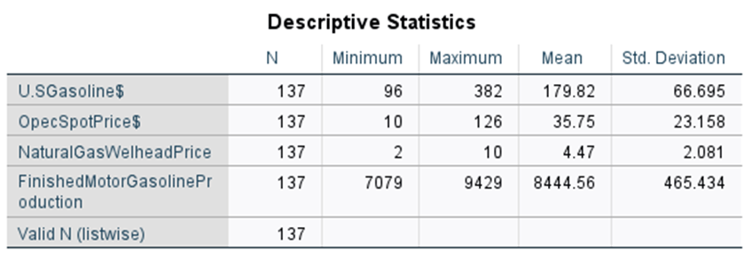
12 YEAR GASOLINE
The 12-year time-series gasoline database contains monthly data for four variables: U.S. Gasoline Prices, OPEC Spot Price, U.S. Finished Motor Gasoline Production, and U.S. Natural Gas Wellhead Price. There are 137 data entries for each variable. U.S. Gasoline Prices are given in cents, the OPEC Spot Price is given in dollars per barrel, U.S. Finished Motor Gasoline Production is given in 1000 barrels per day, and U.S. Natural Gas Wellhead Price is given in dollars per 1000 cubic feet

Slide 4
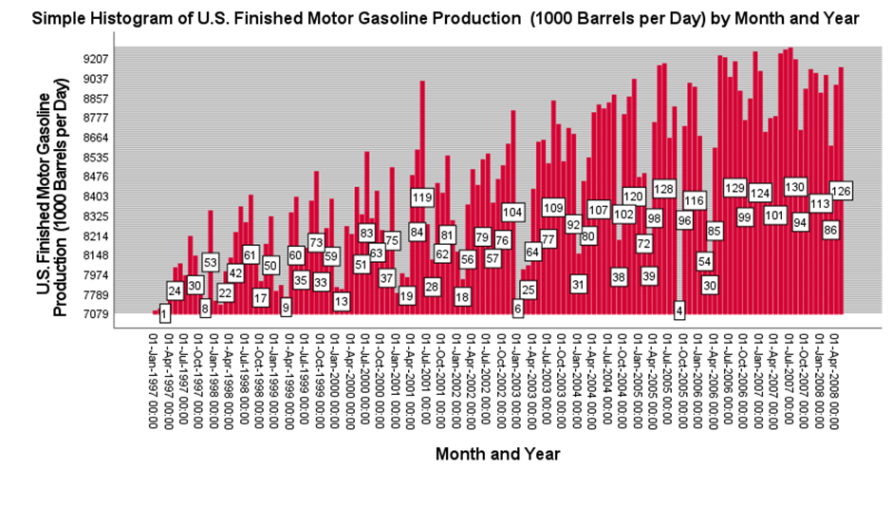

Slide 5
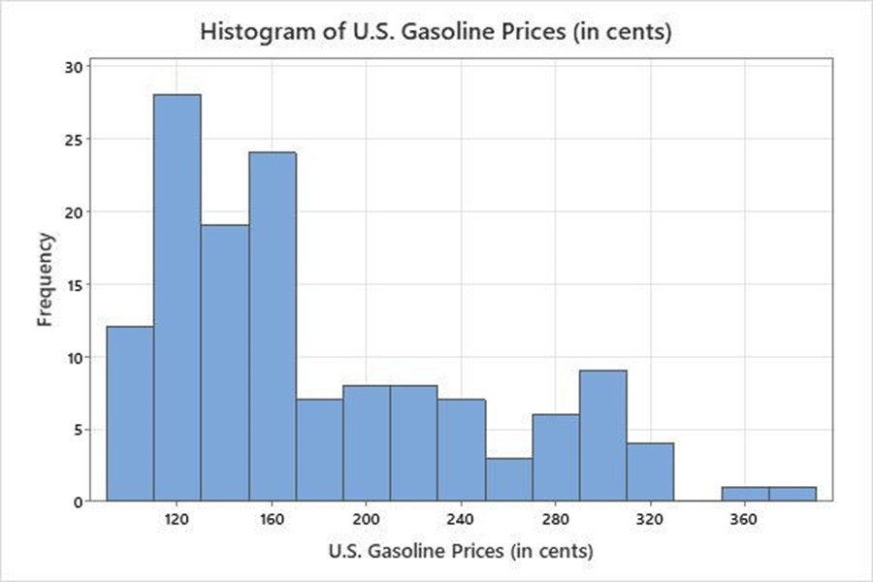
12 YEAR GASOLINE CONT.

Slide 6
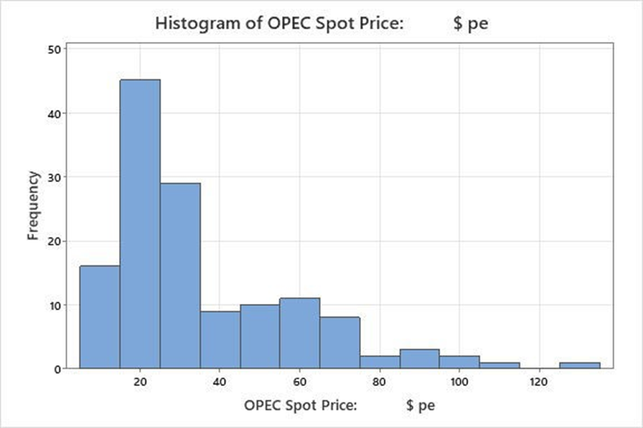
12 YEAR GASOLINE CONT.

Slide 7
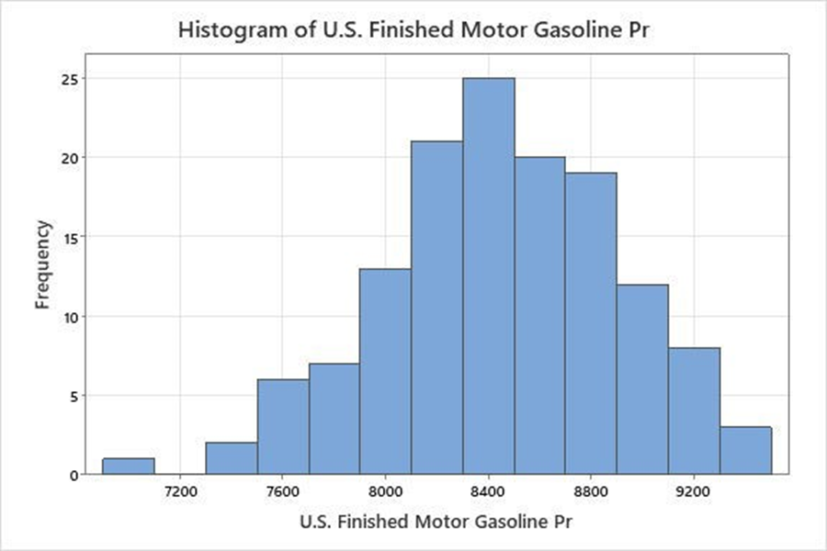
12 YEAR GASOLINE CONT.

Slide 8
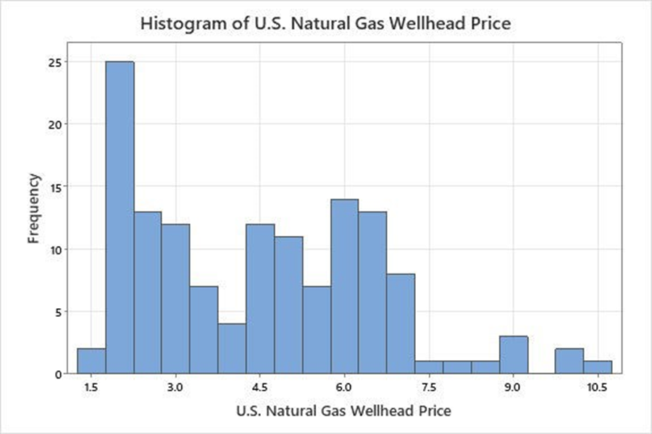
12 YEAR GASLOINE CONT.

Slide 9
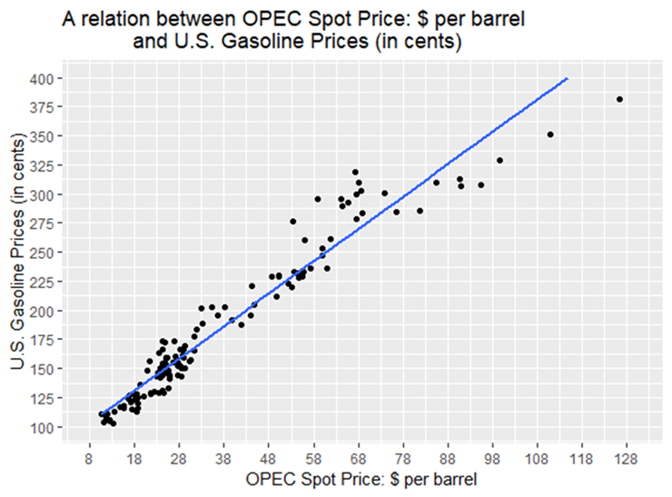

Slide 10
AGRICULTURE
The agriculture database contains the monthly weight (in 1000 lbs.) of cold storage holdings for six different vegetables and for total frozen vegetables over a 14-year period. Each of the seven variables represents 168 months of data. The six vegetables are green beans, broccoli, carrots, sweet corn, onions, and green peas. The data are published by the National Agricultural Statistics Service of the U.S. Department of Agriculture

Slide 11
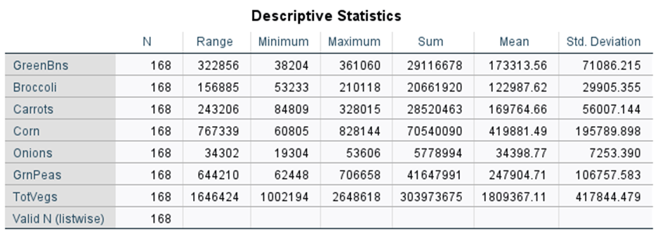
AGRICULTURE
Table 18: Model Statistics
Model | Number of Predictors | Model Fit statistics | Ljung-Box Q(18) |  |  | Number of Outliers
 |  | Stationary R-squared | Statistics | DF | Sig.
GreenBeans-Model_1 | 0 | .897 | 62.869 | 14 | .000 | 0
Broccoli-Model_2 | 0 | .213 | 86.754 | 16 | .000 | 0
Carrots-Model_3 | 0 | .916 | 61.160 | 15 | .000 | 0
Corn-Model_4 | 0 | .921 | 56.215 | 13 | .000 | 0
Onions-Model_5 | 0 | .063 | 16.654 | 17 | .478 | 0
GreenPeas-Model_6 | 0 | .784 | 22.452 | 14 | .070 | 0
TotalVegs-Model_7 | 0 | .966 | 32.319 | 14 | .004 | 0

Slide 12
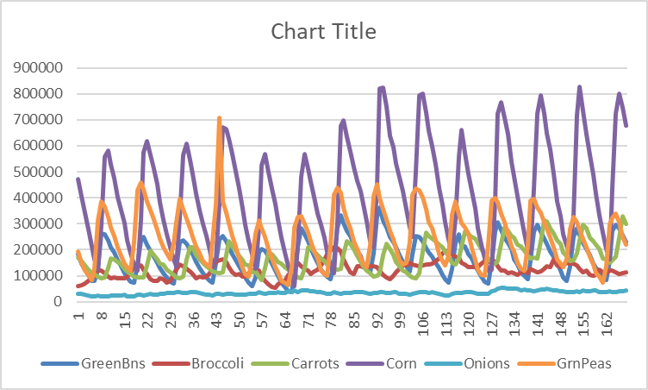
AGRICULTURE CONT.

Slide 13
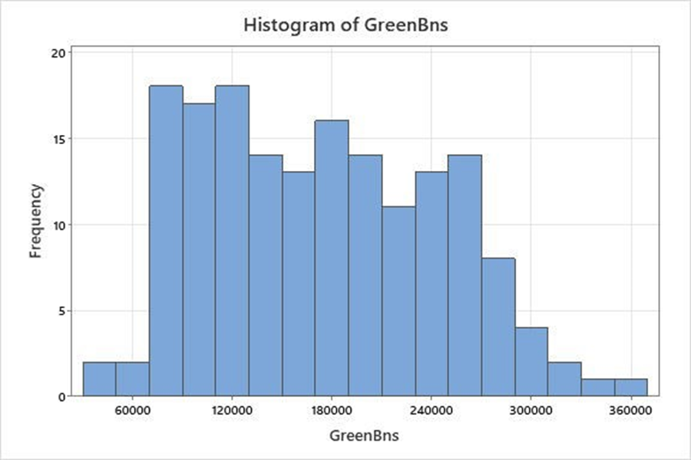
AGRICULTURE CONT.

Slide 14
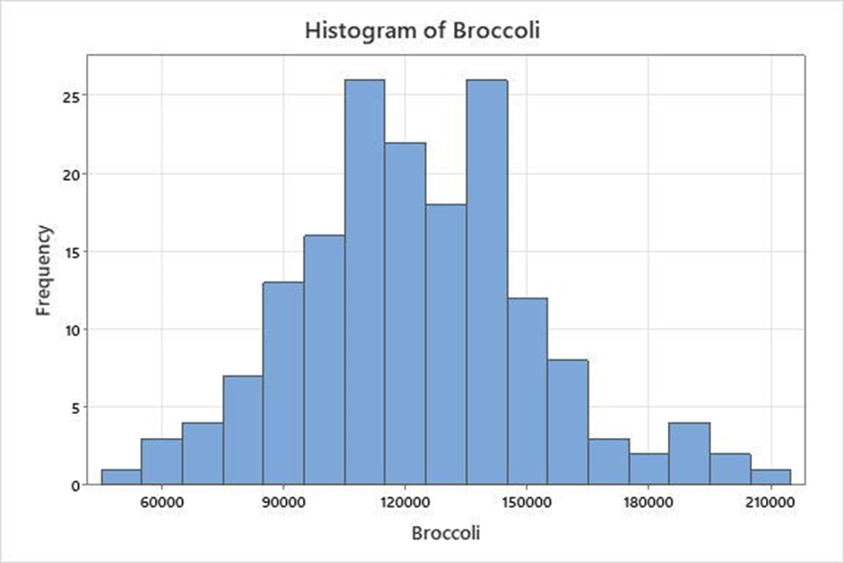
AGRICULTURE CONT.

Slide 15
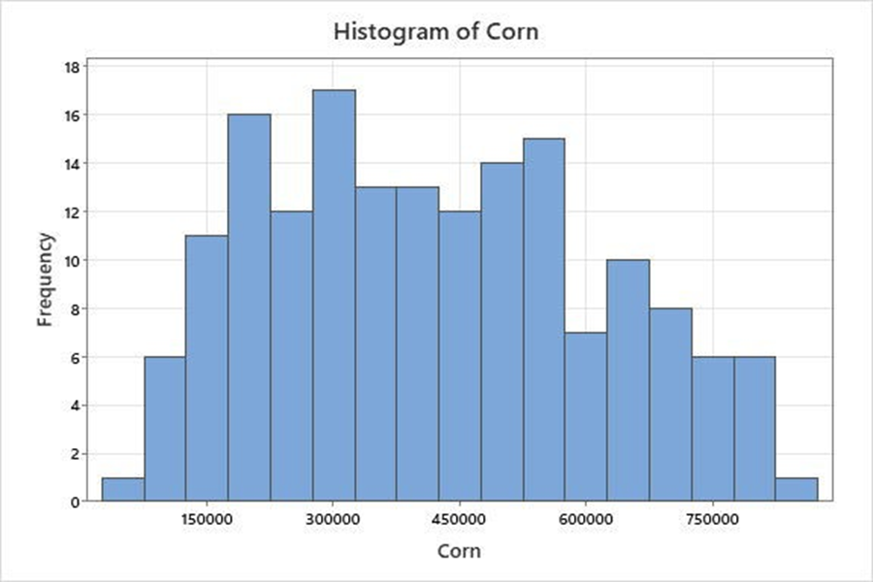
AGRICULTURE CONT.

Slide 16
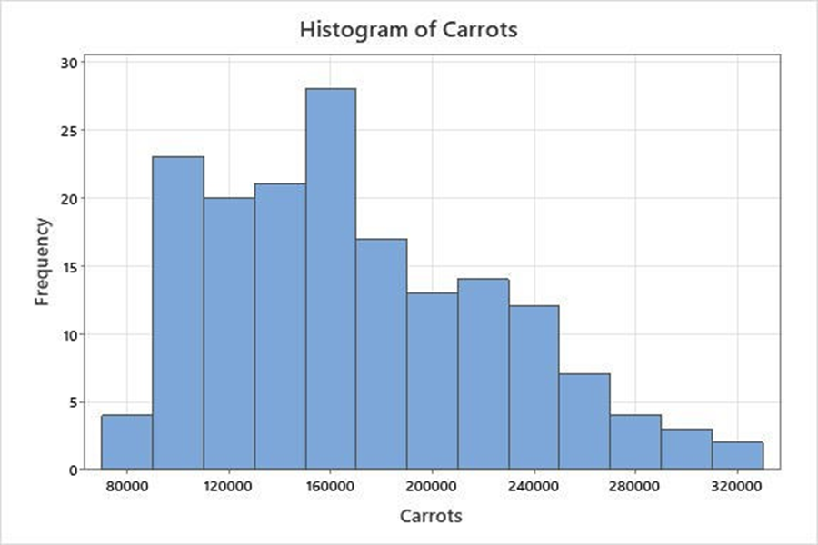
AGRICULTURE CONT.

Slide 17
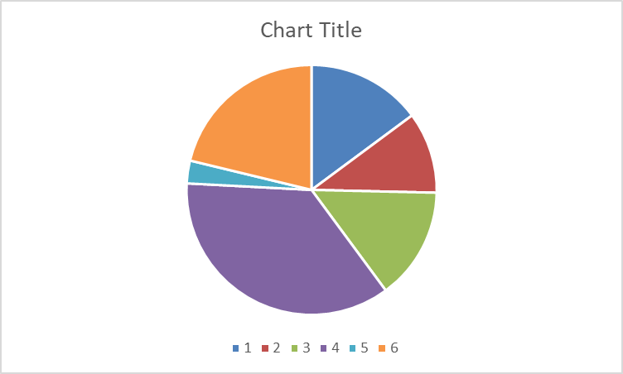
PIECHART OF THE VEGGIES
1 = GREEN BEANS
2 =BROCCOLI
3 =CARROTS
4 =CORN
5 =ONIONS
6 = GREEN PEAS

Slide 18
CONSUMER FOOD
The consumer food database contains five variables: Annual Food Spending per Household, Annual Household Income, Non-Mortgage Household Debt, Geographic Region of the U.S. of the Household, and Household Location. There are 200 entries for each variable in this database representing 200 different households from various regions and locations in the United States. Annual Food Spending per Household, Annual Household Income, and Non-Mortgage Household Debt are all given in dollars. The variable Region tells in which one of four regions the household resides. In this variable, the Northeast is coded as 1, the Midwest is coded 2, the South is coded as 3, and the West is coded as 4. The variable Location is coded as 1 if the household is in a metropolitan area and 2 if the household is outside a metro area. The data in this database were randomly derived and developed based on actual national norms.

Slide 19
CONSUMER FOOD

Slide 20
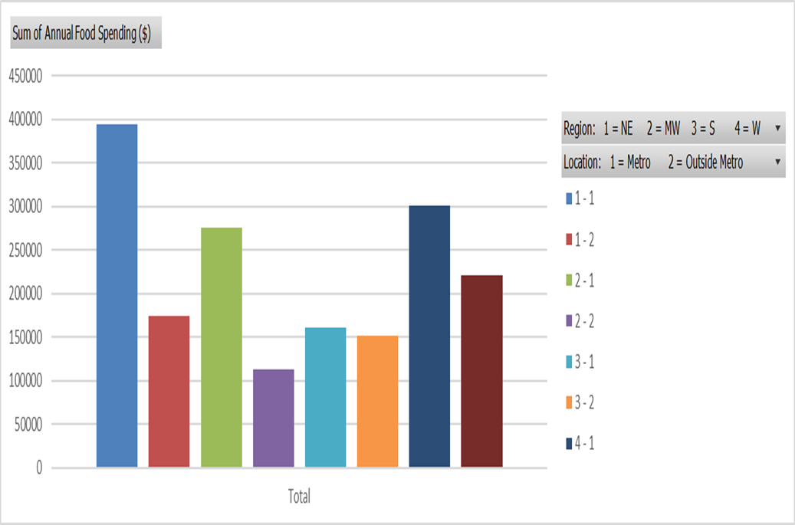
CONSUMER FOOD CONT.

Slide 21
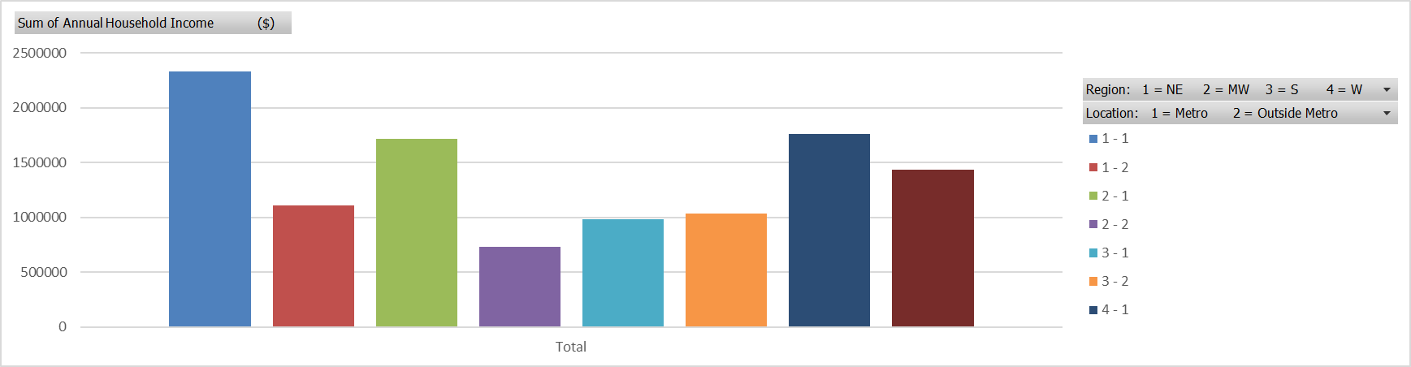
CONSUMER FOOD CONT.

Slide 22
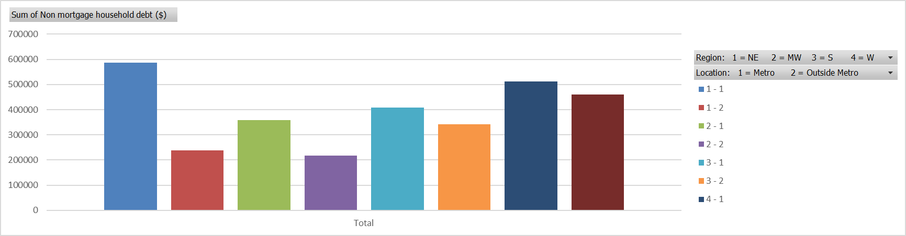
CONSUMER FOOD CONT.

Slide 23
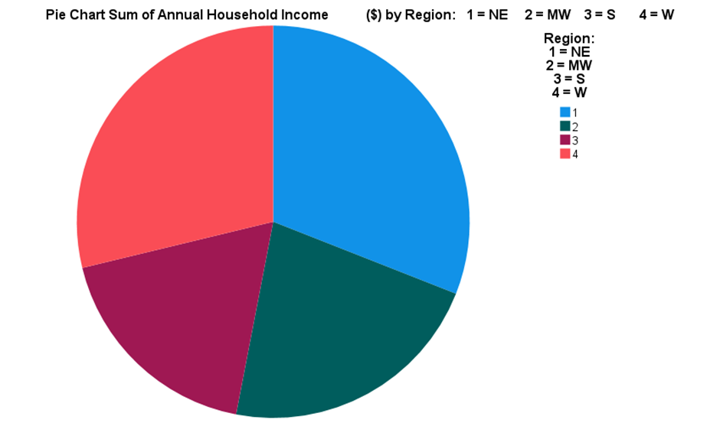
CONSUMER FOOD CONT.

Slide 24
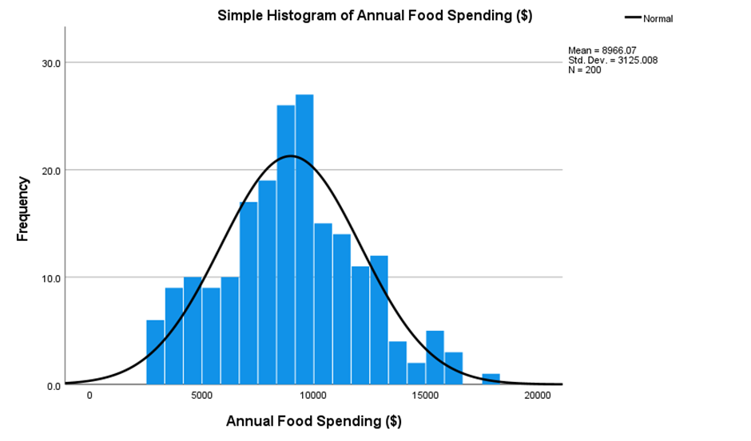
CONSUMER FOOD CONT.

Slide 25
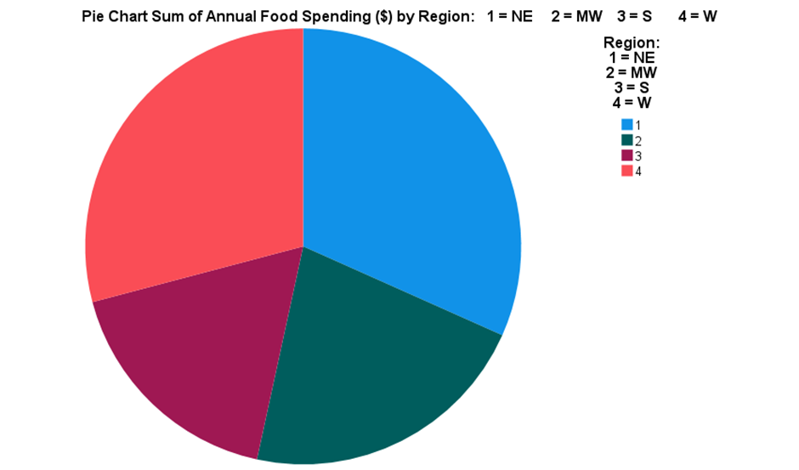
CONSUMER FOOD CONT.

Slide 26
CONSUMER FOOD CONT.
ANOVAª
Model |  | Sum of Squares | df | Mean Square | F | Sig.
1 | Regression | 2332095.145 | 1 | 2332095.145 | .011 | .917^{b}
 | Residual | 42773808187.125 | 198 | 216029334.278
 | Total | 42776140282.271 | 199
a. Dependent Variable: Annual Household Income ($)
b. Predictors: (Constant), Region: 1 = NE 2 = MW 3 = S 4 = W
F-critical= 3.888583

Slide 27
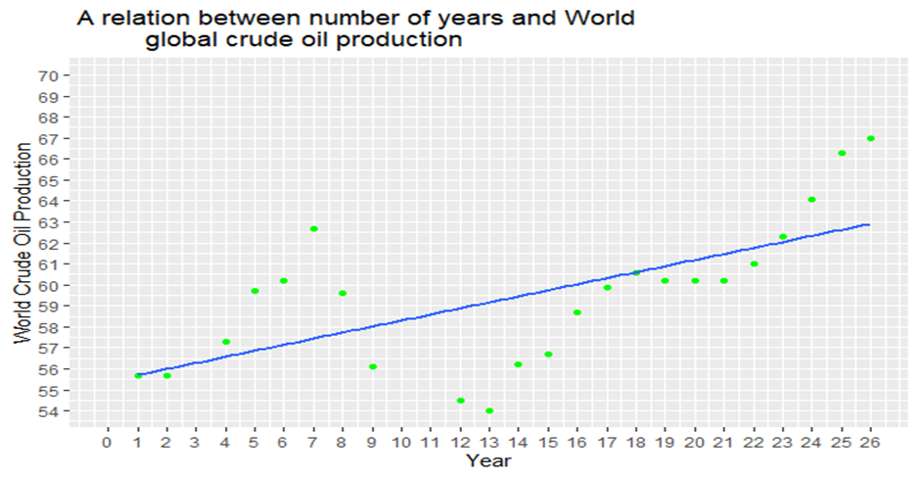
ENERGY
The time-series energy database consists of data on five energy variables over a period of 26 years. The five variables are U.S. Energy Consumption, World Crude Oil Production, U.S. Nuclear Electricity Generation, U.S. Coal Production, and U.S. Natural Dry Gas Production. U.S. Energy Consumption is given in quadrillion BTUs per year, World Crude Oil Production is given in million barrels per day, U.S. Nuclear Electricity Generation is given in billion kilowatt-hours, U.S. Coal Production is given in million short tons, and U.S. Natural Dry Gas Production is given in million cubic feet

Slide 28
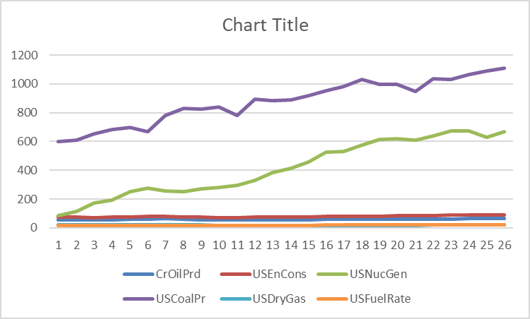
ENERGY CONT.

Slide 29
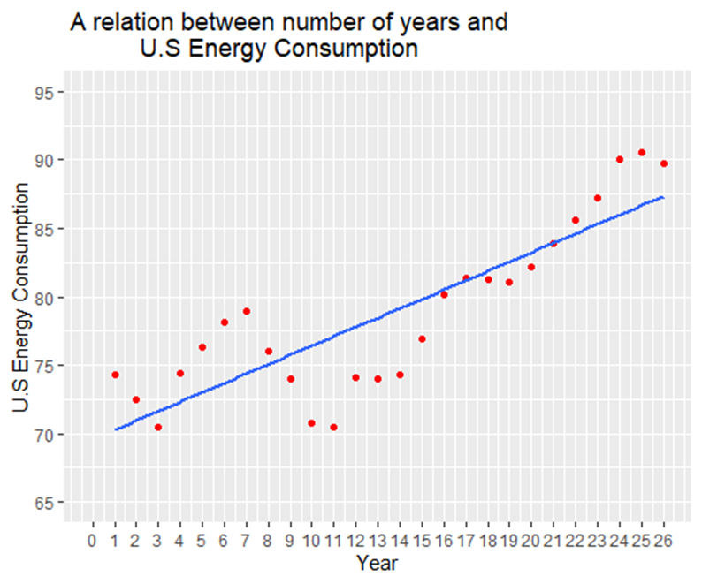
ENERGY CONT.

Slide 30
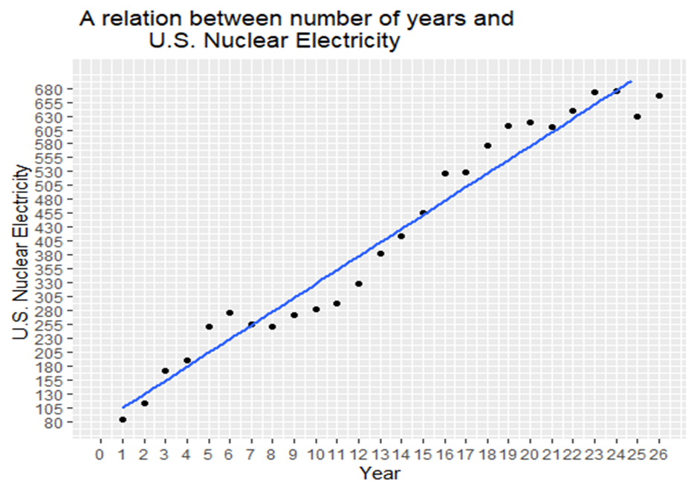
ENERGY CONT.

Slide 31
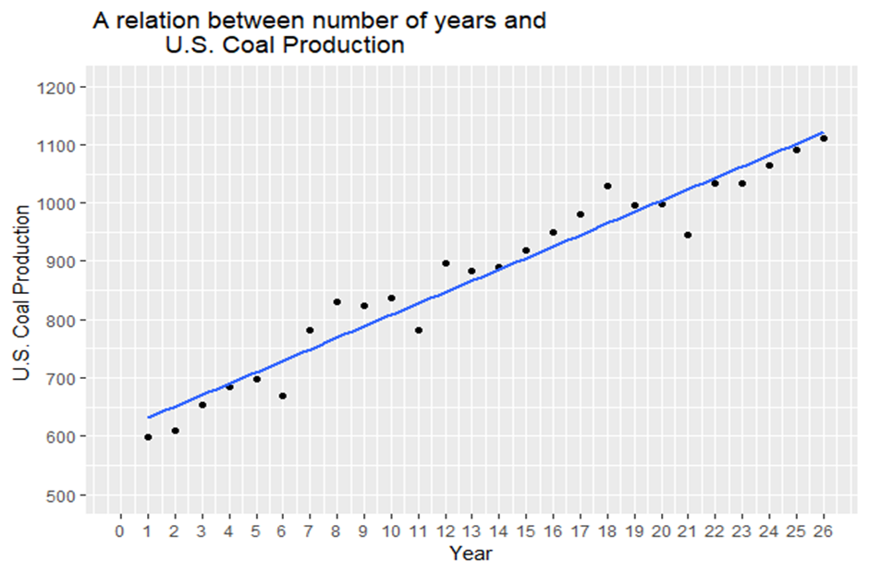
ENERGY CONT.

Slide 32
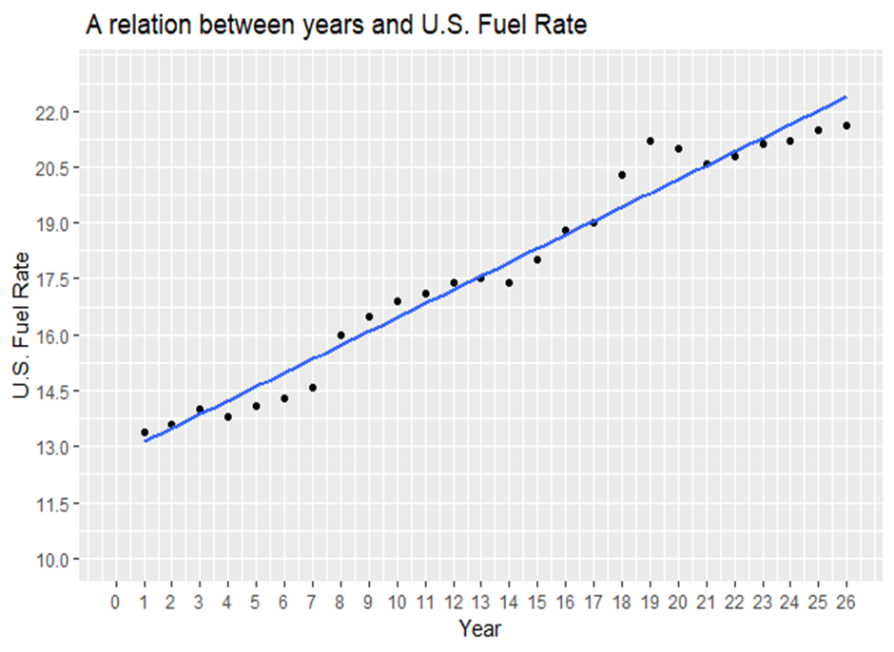
ENERGY CONT.

Slide 33
FINANCIAL
The financial database contains observations on eight variables for 100 companies. The variables are Type of Industry, Total Revenues ($ millions), Total Assets ($ millions), Return on Equity (%), Earnings per Share ($), Average Yield (%), Dividends per Share ($), and Average Price per Earnings (P/E) ratio. The companies represent seven different types of industries. The variable Type displays a company’s industry type as: 1 = apparel 2 = chemical 3 = electric power 4 = grocery 5 = healthcare products 6 = insurance 7 = petroleum

Slide 34
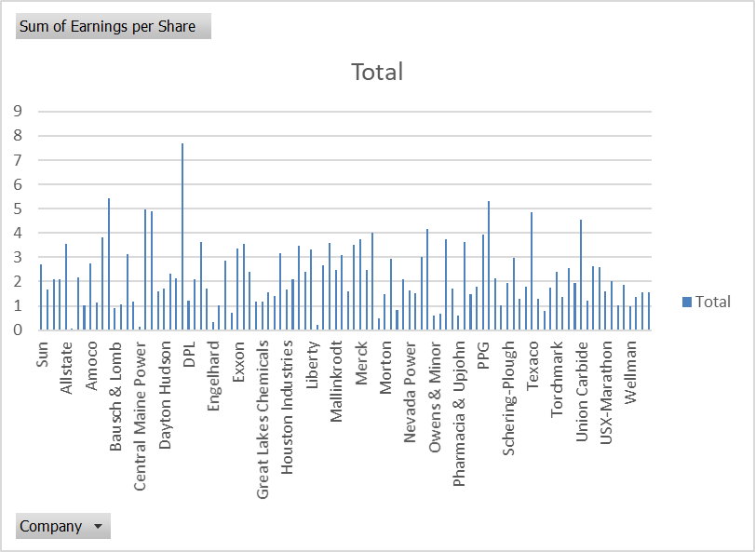
FINANCIAL

Slide 35
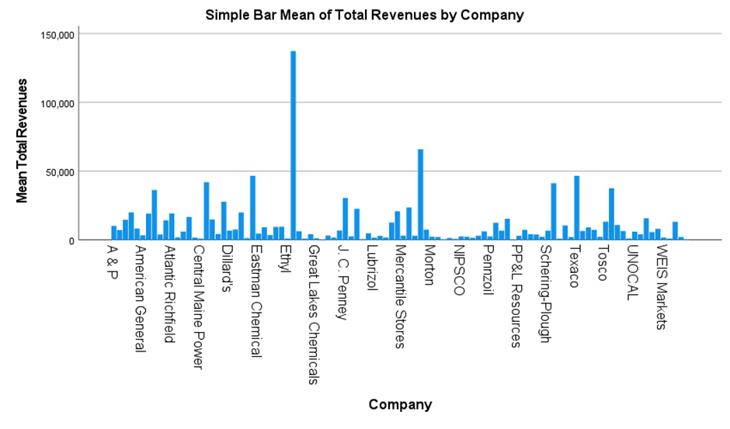
FINANCIAL CONT.

Slide 36
FINANCIAL CONT.

Slide 37
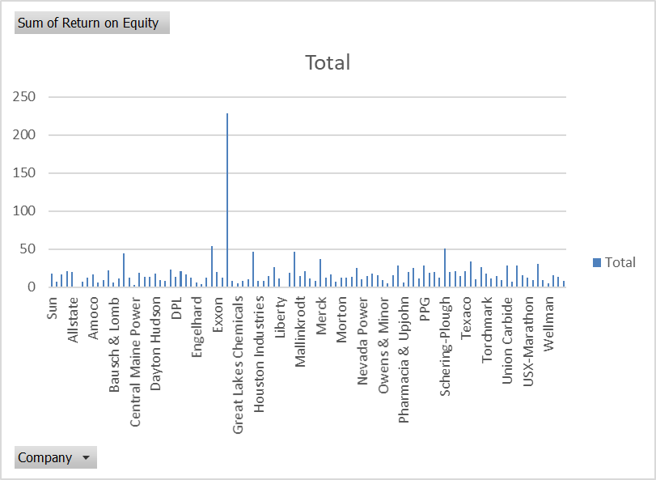
FINANCIAL CONT.

Slide 38
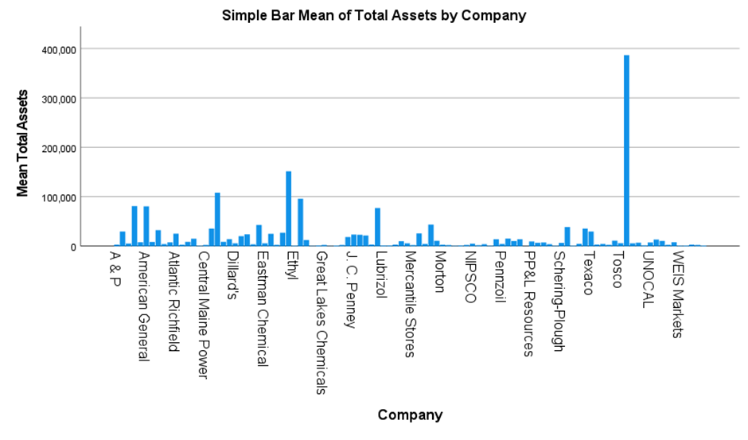
FINANCIAL CONT.

Slide 39
FINANCIAL CONT.
ANOVA
 |  | Sum of Squares | df | Mean Square | F | Sig
Between People |  | 143092733666.520 | 99 | 1445381148.147
Within People | Between Items | 3051070351.220 | 1 | 3051070351.220 | 3.631 | .060
 | Residual | 83190487487.780 | 99 | 840307954.422
 | Total | 86241557839.000 | 100 | 862415578.390
Total |  | 229334291505.520 | 199 | 1152433625.656
Grand Mean = 14949.18

Slide 40
INTERNATIONAL LABOR
The international stock markets of the US, Tokyo, Hong Kong, London, and Mexico are important financial centers that attract investors from all over the world. The performance of these markets is closely watched by investors and analysts, as it reflects the overall economic health and political stability of these countries. In this report, we will analyze the performance of these international stock markets over a period of time.

Slide 41
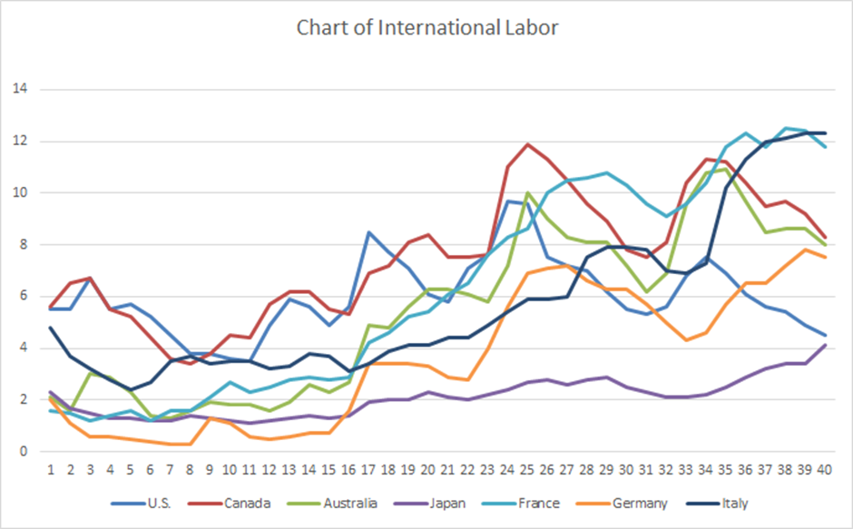
INTERNATIONAL LABOUR

Slide 42
INTERNATIONAL LABOR CONT.

Slide 43
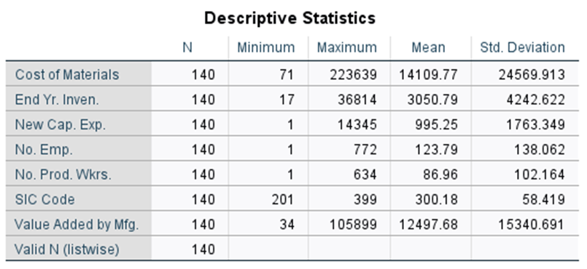
MANUFACTURER
This database contains eight variables taken from 20 industries and 140 subindustries in the United States. Some of the industries are food products, textile mill products, furniture, chemicals, rubber products, primary metals, industrial machinery, and transportation equipment. The eight variables are Number of Employees, Number of Production Workers, Value Added by Manufacture, Cost of Materials, Value of Industry Shipments, New Capital Expenditures, End-of-Year Inventories, and Industry Group. Two variables, Number of Employees and Number of Production Workers, are in units of 1000. Four variables, Value Added by Manufacture, Cost of Materials, New Capital Expenditures, and End-of-Year Inventories, are in million-dollar units. The Industry Group variable consists of numbers from 1 to 20 to denote the industry group to which the particular subindustry belongs. Value of Industry Shipments has been recoded to the following 1 to 4 scale.

Slide 44
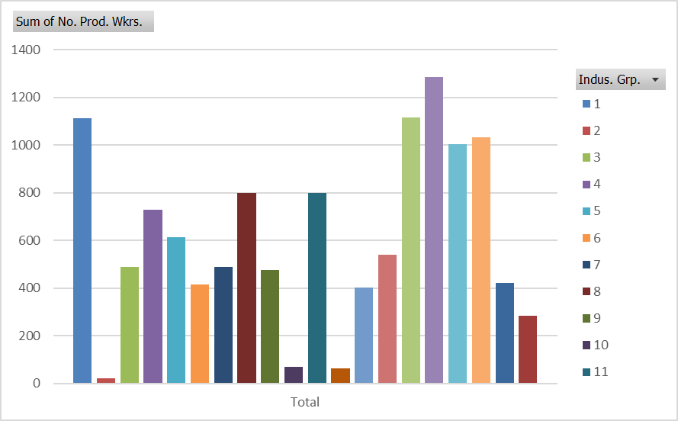
MANUFACTURER CONT.

Slide 45
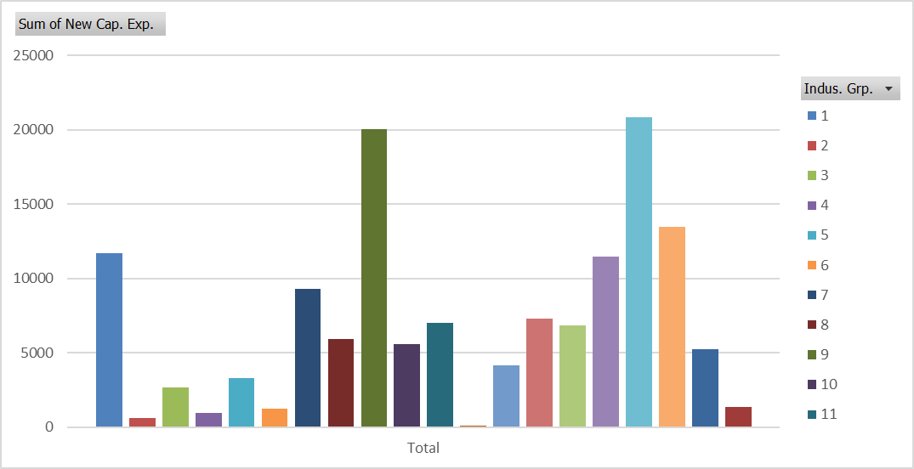
MANUFACTURER CONT.

Slide 46
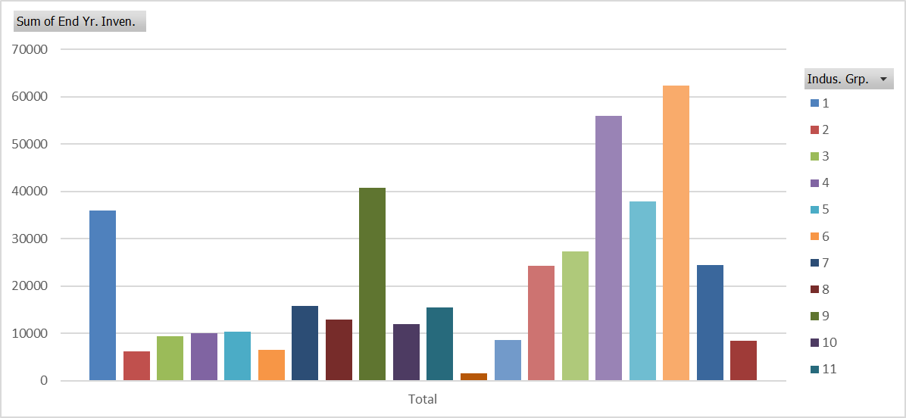
MANUFACTURER CONT.

Slide 47
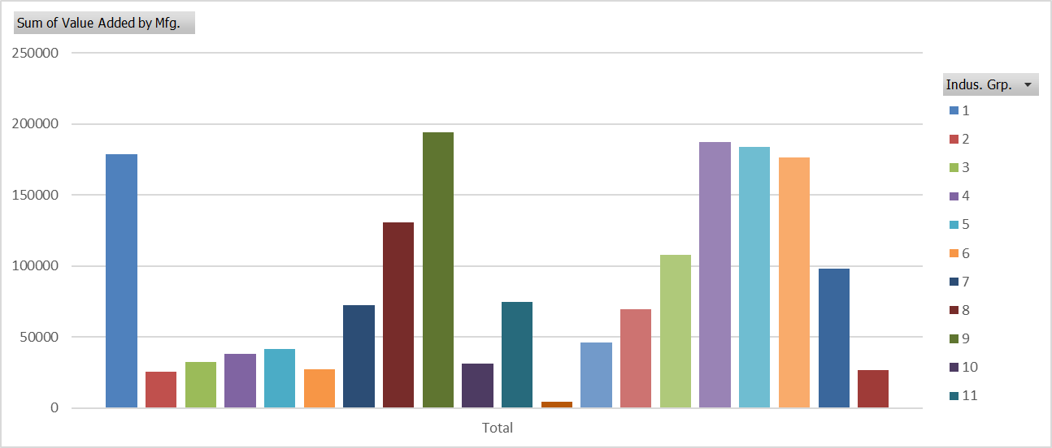
MANUFACTURER CONT.

Slide 48
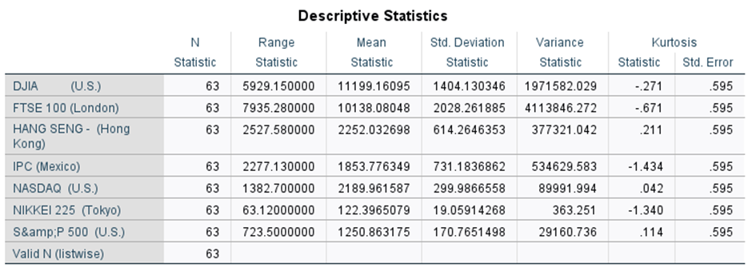
US AND INTERNATIONAL STOCK MARKET
This database contains seven variables—three from the U.S. stock market and four from international stock markets—with data representing monthly averages of each over a period of five years resulting in 60 data points per variable. The U.S. stock market variables include the Dow Jones Industrial Average, the NASDAQ, and Standard & Poor’s 500. The four international stock market variables of Nikkei 225, Hang Seng, FTSE 100, and IPC represent Japan, Hong Kong, United Kingdom, and Mexico.

Slide 49
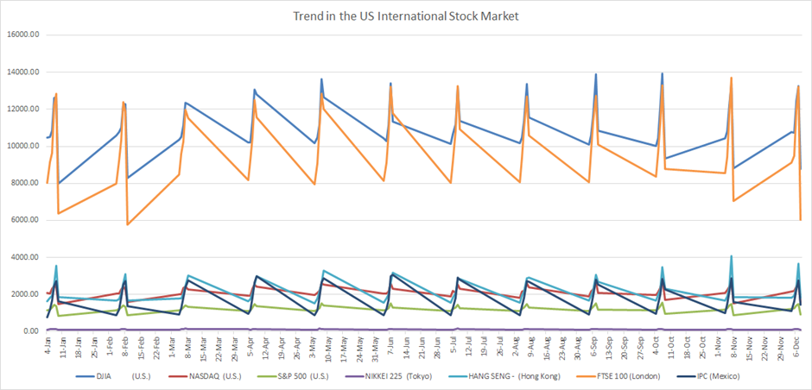
US AND INTERNATIONAL STOCK MARKET

Slide 50
CONCLUSION
Overall, the use of data-driven approaches in business decision-making has become increasingly important in today's competitive and rapidly changing business environment. By leveraging the power of data, organizations can gain valuable insights into market trends, customer behavior, and operational performance, among other factors, to make more informed decisions and stay ahead of the competition. As such, it is essential for companies to invest in data analytics and build the necessary capabilities to leverage data as a strategic asset in their decision-making processes.

